Slide 1


Predicting Customer Pricing
Daniel Piddock

Slide 2
Aim
Explore the dataset
Analyse the dataset
Create a model to predict how much to charge a customer
Evaluate the accuracy of the model

Slide 3
Data Exploration – My Interpretation
Look through the dataset for important features
Identify things such as missing values and anomalies in the dataset
Visualise the properties of the dataset with different plots
Identify influential variables to use in the modelling process

Slide 4
Data Exploration – Interesting Features
Some data was inconsistent or out of place
Some data was missing from the second driver columns
Chose to ignore the effects of a second driver in my model

Slide 5
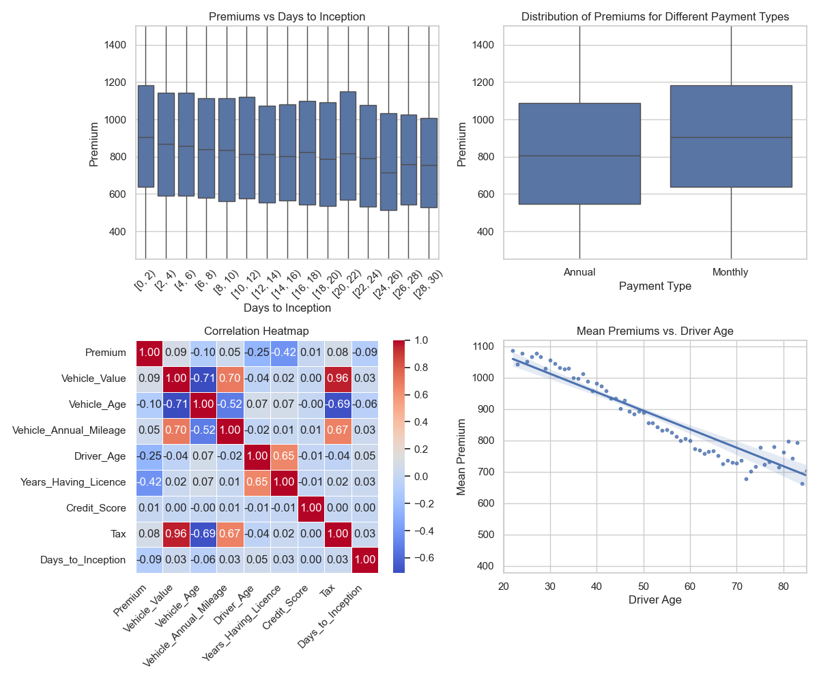

Slide 6
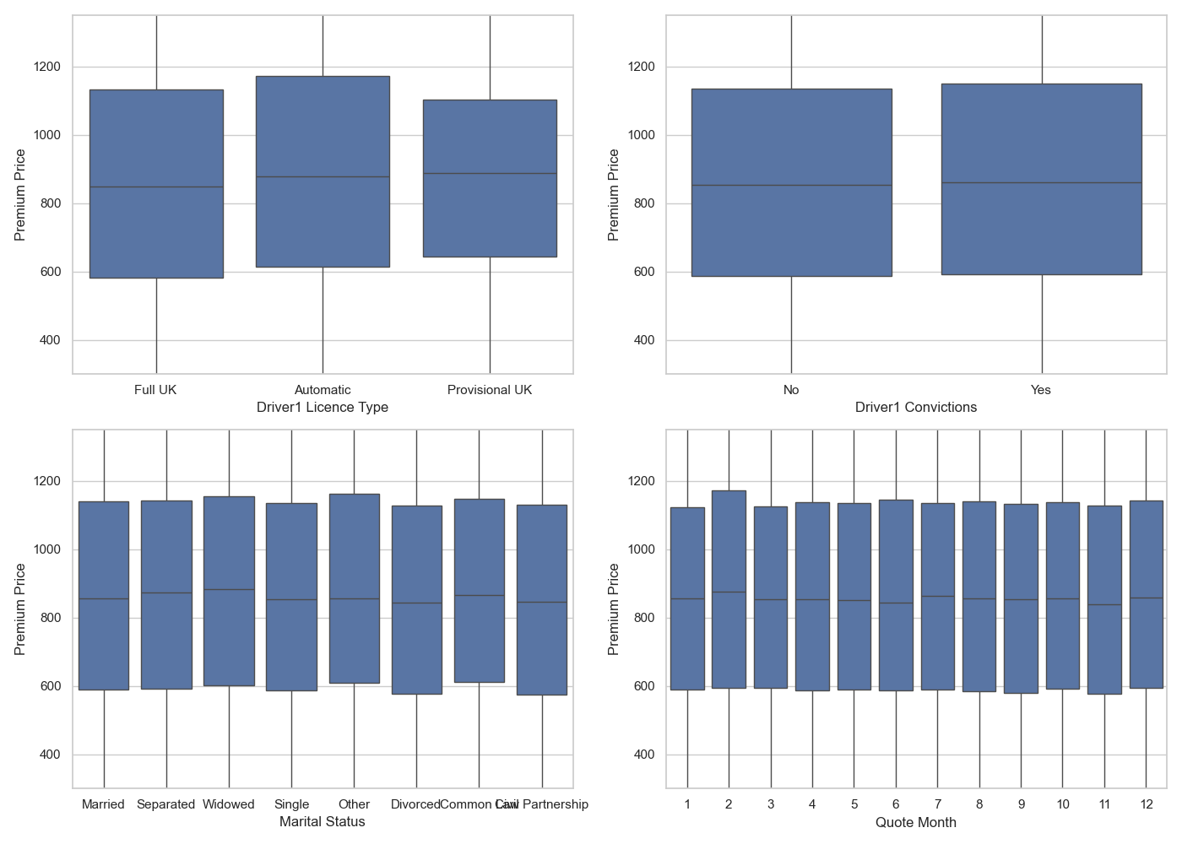

Slide 7
Variables I chose to consider
Driver age
Vehicle value
Vehicle age
How many years the driver has had a licence
Tax
Days to Inception
Monthly vs Annual Payment Type

Slide 8
Outline of my modelling process
Data cleaning
Using cleaned data try out different models
Evaluate the effectiveness of each model based on different metrics
Combine models to make a more effective model

Slide 9
Modelling – Data Cleaning
Dropped duplicate rows
Removed inconsistent or out of place data
Changed variables to work properly in Python
5 methods to remove extreme values: Isolation Forest, Local Outlier Factor, Median Absolute Deviation, Interquartile Range, and z-score Normalisation

Slide 10
Model - Design
Used the variables chosen from data exploration
Tried 11 initial models in Python: ElasticNet, XGBoost, Linear Regression, Bayesian Regression, Random Forest Regressor, GAM, KNN Regression, AdaBoost Regression, Lasso Regression, Ridge Regression, Decision Tree Regression
Adjusted the models to give me the best R², MSE, RMSE, and MAE values
Gradient Boosting model (XGBoost) and Generalised Additive Model (pyGAM) were the top preforming standalone models
Combined multiple models to improve accuracy

Slide 11
Model - assumptions
The Generalised Additive Model (GAM) assumes that the relationship between Premium Price and the predictors is additive
Also assumes that predictors contribute independently to the outcome
Allows for non-linear relationships
The Gradient Boosting algorithm don’t rely on assumptions about the data distribution

Slide 12
Conclusions – Main Findings
An ensemble model between XGBoost and GAM provided the best R² value when combined with the Local Outlier Factor method of cleaning
The best R² value was 0.252
The same model with Isolation Forest cleaning provided the best MSE and MAE values
Best MSE and MAE was 119805 and 277 respectively

Slide 13
Results
Ensemble XGBoost + GAM with Isolation Forest cleaning
Ensemble XGBoost + GAM with Local Outlier Factor cleaning

Slide 14
Comments on results
Model is inaccurate for younger drivers but more reliable for older drivers
Input my father's driver information into my model and compared it with a real quote from Hastings Direct
My model gave a premium price of £602 and Hastings Directs premier policy quote was £596
Room for improvement

Slide 15
Other useful information to have known
Vehicle specifications
Black box (YouDrive policy)
Driving history
Car modifications
Geographic Location
Policy coverage details
No claims bonus

Slide 16
Any questions?

